Slide 1
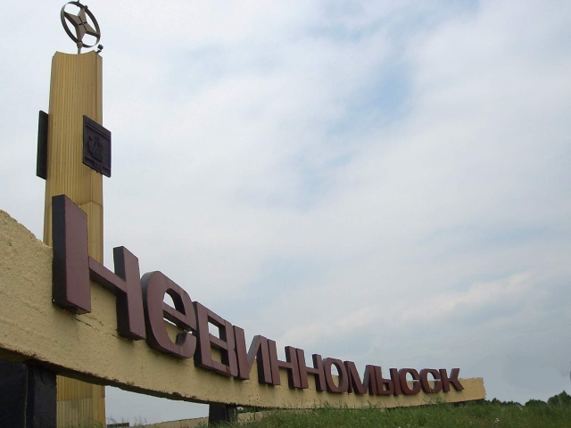
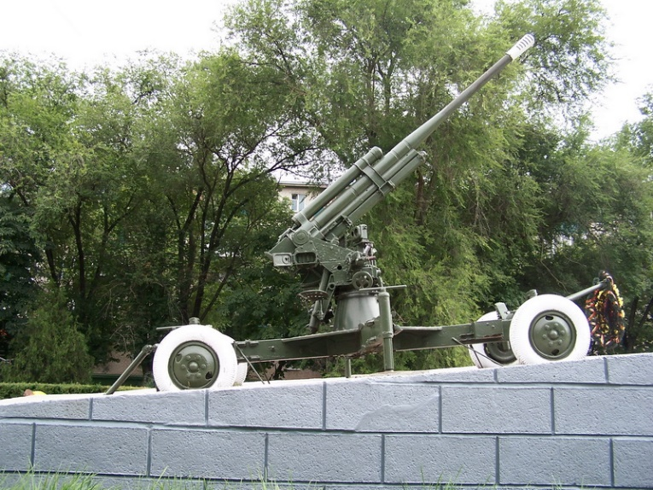
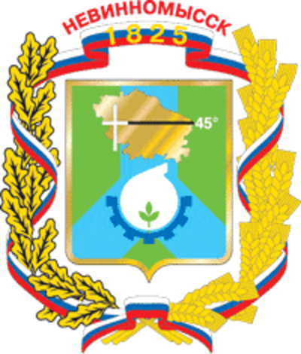
January 21, 1943 Nevinnomyssk was freed from Nazi occupation. A few months the city was in occupation. But our ancestors did not subject themselves to the enemy, many of them on the path of struggle against the invaders. About the fierce battles for the city today resemble military graves, obelisks, located on the territory of Nevinnomyssk.

Slide 2
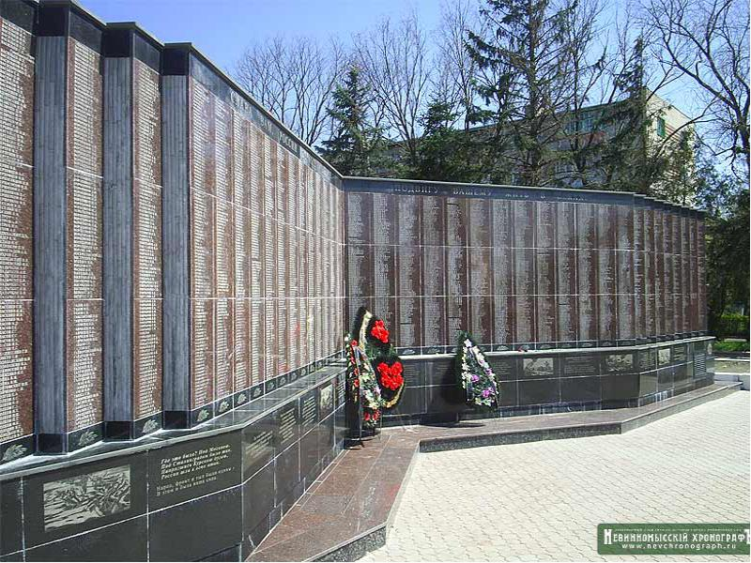
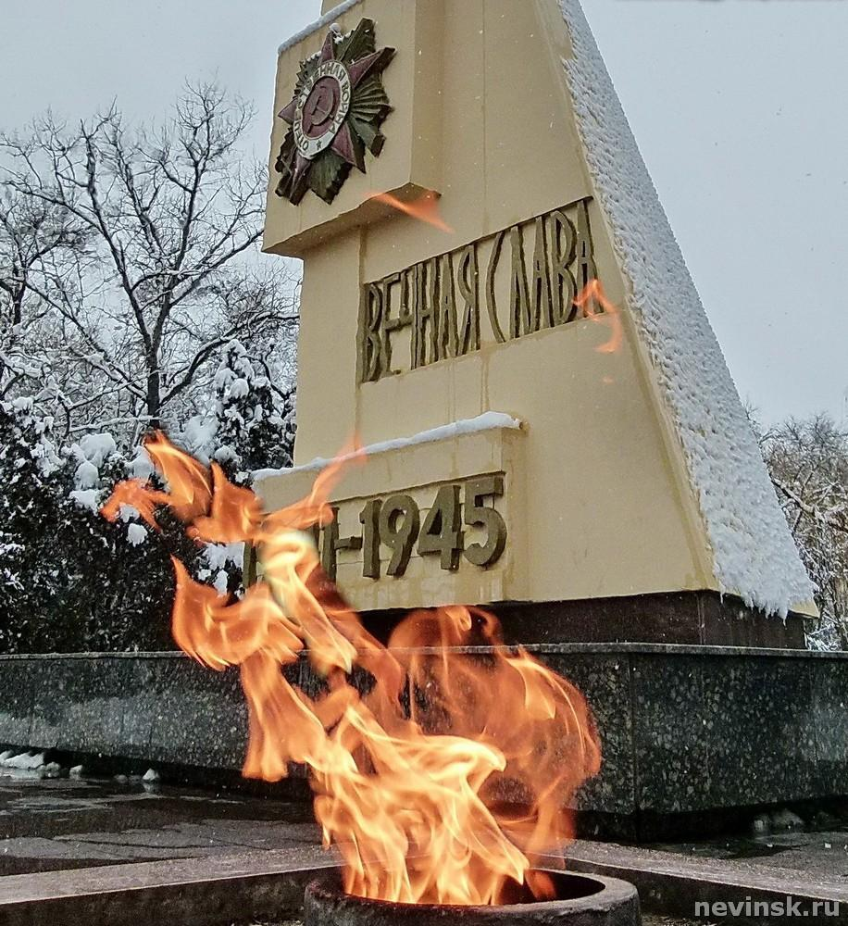
More than 4 million of our countrymen in the Great Patriotic War gave their lives for the liberation of the motherland from the Nazi invaders. Their names are immortalized on the city memorial "Memory Book". Оn its pages immortalized 4004 nevinnomyssks name.

Slide 3
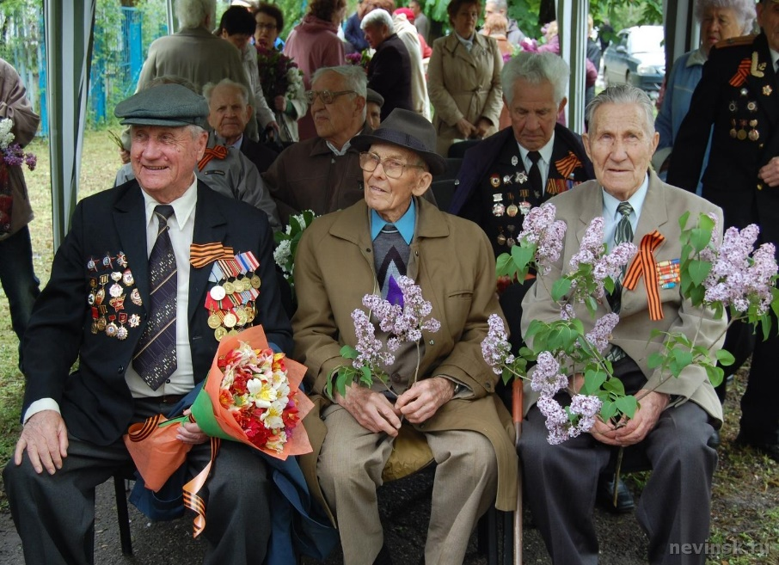
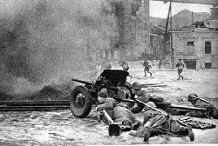
Forever remain in our memory the names of those who defended and liberated our city and region of the hated enemy. Their heroism and selfless devotion to the Motherland, its people and today are a powerful moral factor, a shining example of persistence and dedication, the best guide in the education of the younger generation of patriots. The memory of this feat, we will keep forever, passing from generation to generation.

