Slide 1
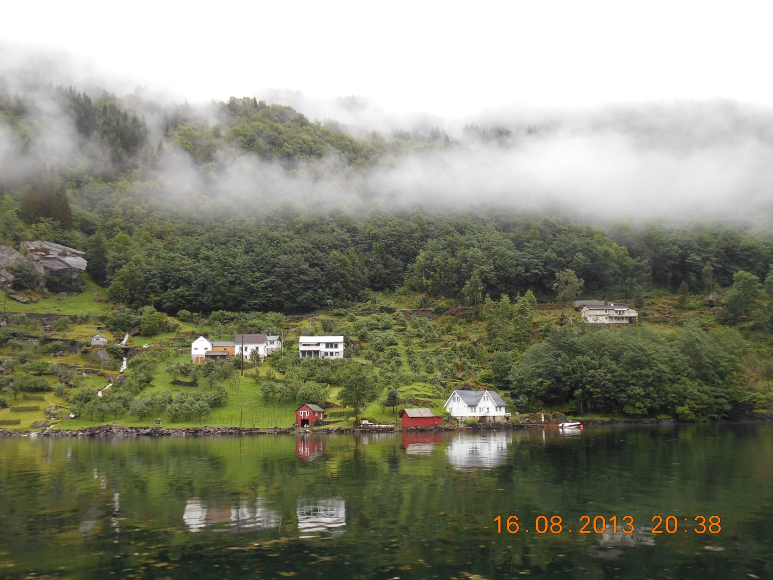
Trip to the countries of Scandinavia.

Slide 2
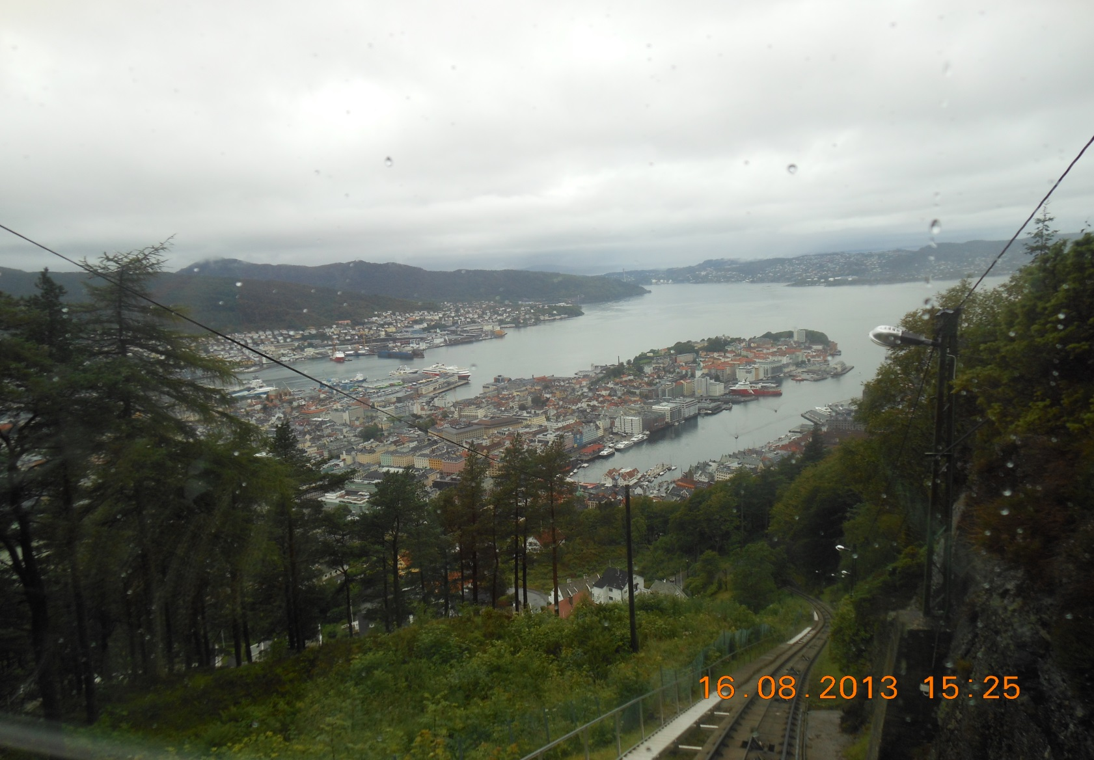
Last summer I went to travel over the countries of Scandinavia. I visited Finland, Sweden, Denmark and Norway. From all of the countries most of all I liked Norway as I fell in love at once with this country, with its magic nature, culture and unusual kindness.

Slide 3
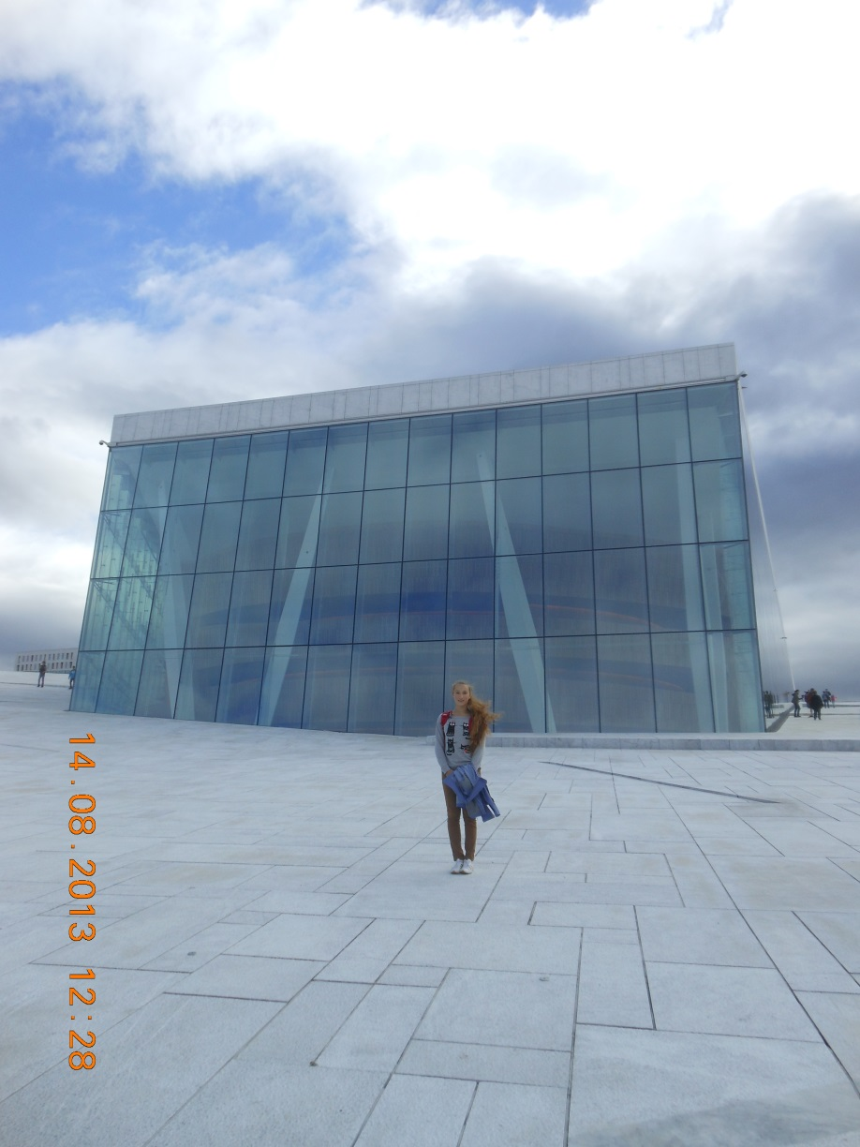
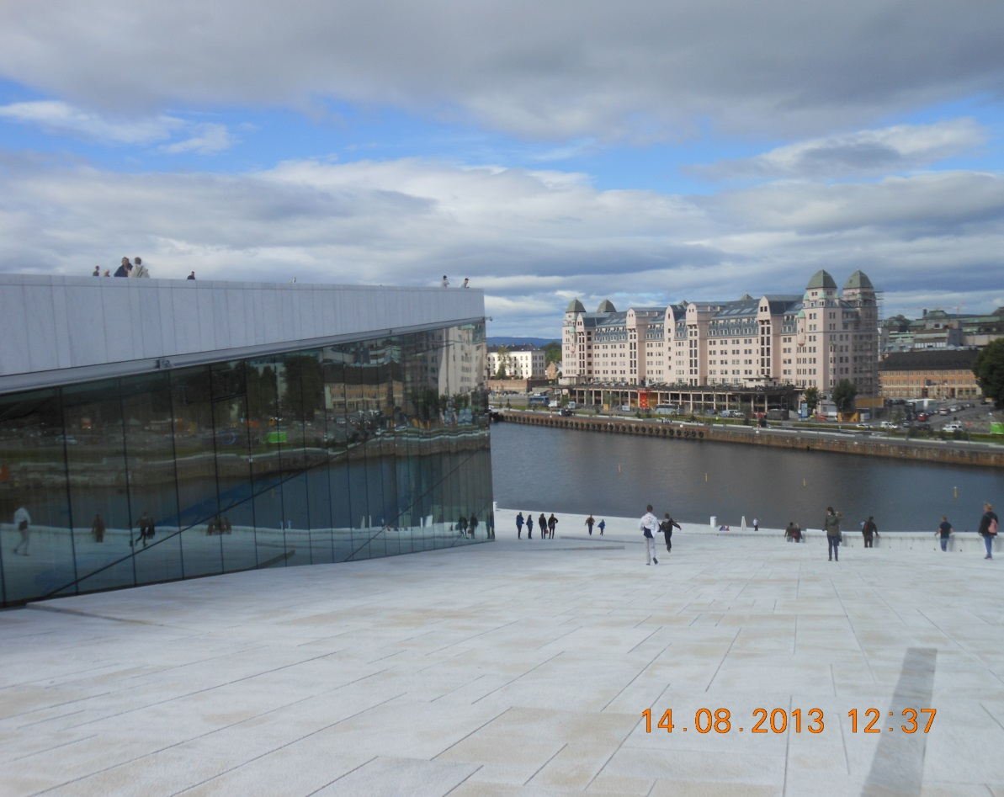
Norway amazing country. As soon as we arrived there, first of all I saw the enormous building of the National opera sight of Norway. The new Norwegian opera which personified harmony and purity of lines by right is considered the most ultramodern around the world.

Slide 4
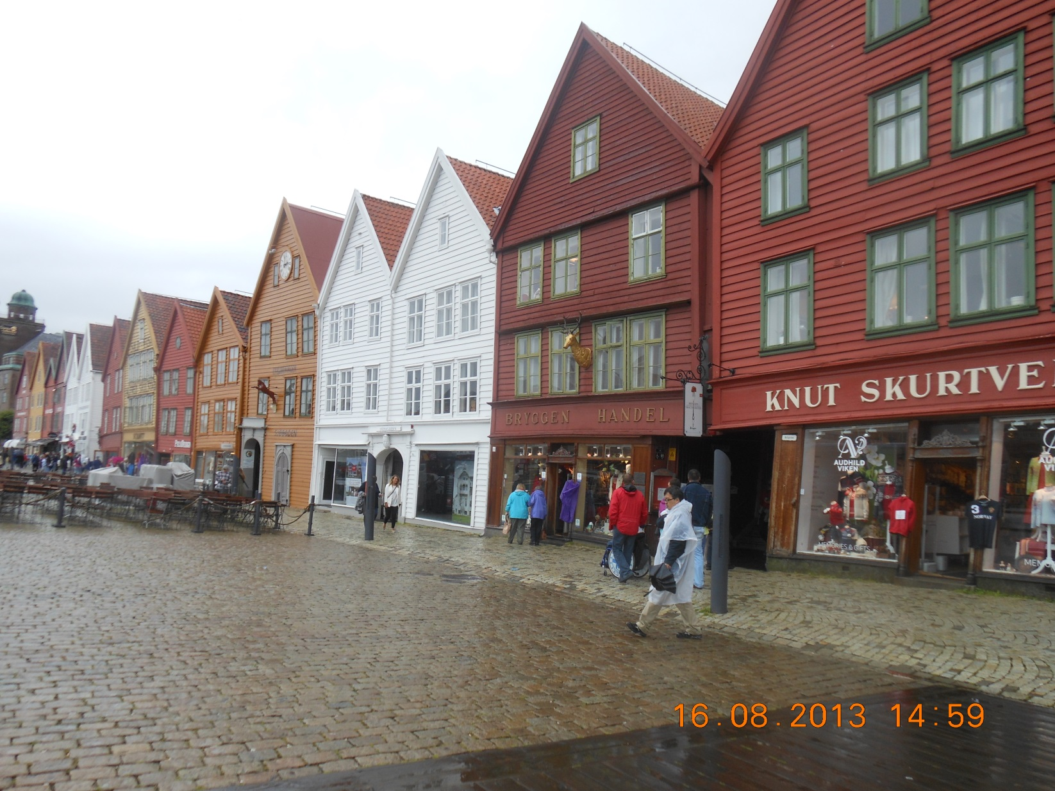
Further we visited Quarter the Bryggen located on the bank of a bay. In the center of quarter there is a set of souvenir shops, art galleries, restaurants and a large market with meat and seafood.

Slide 5
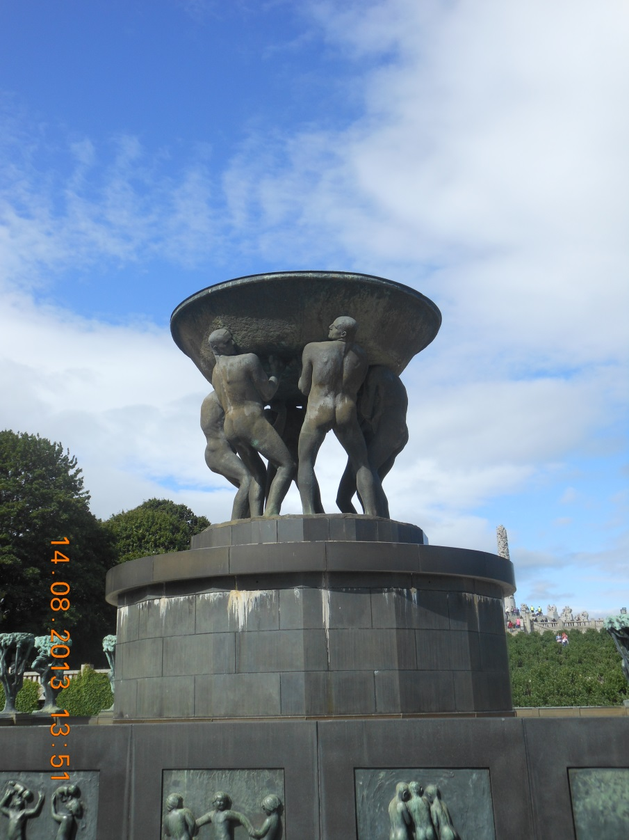
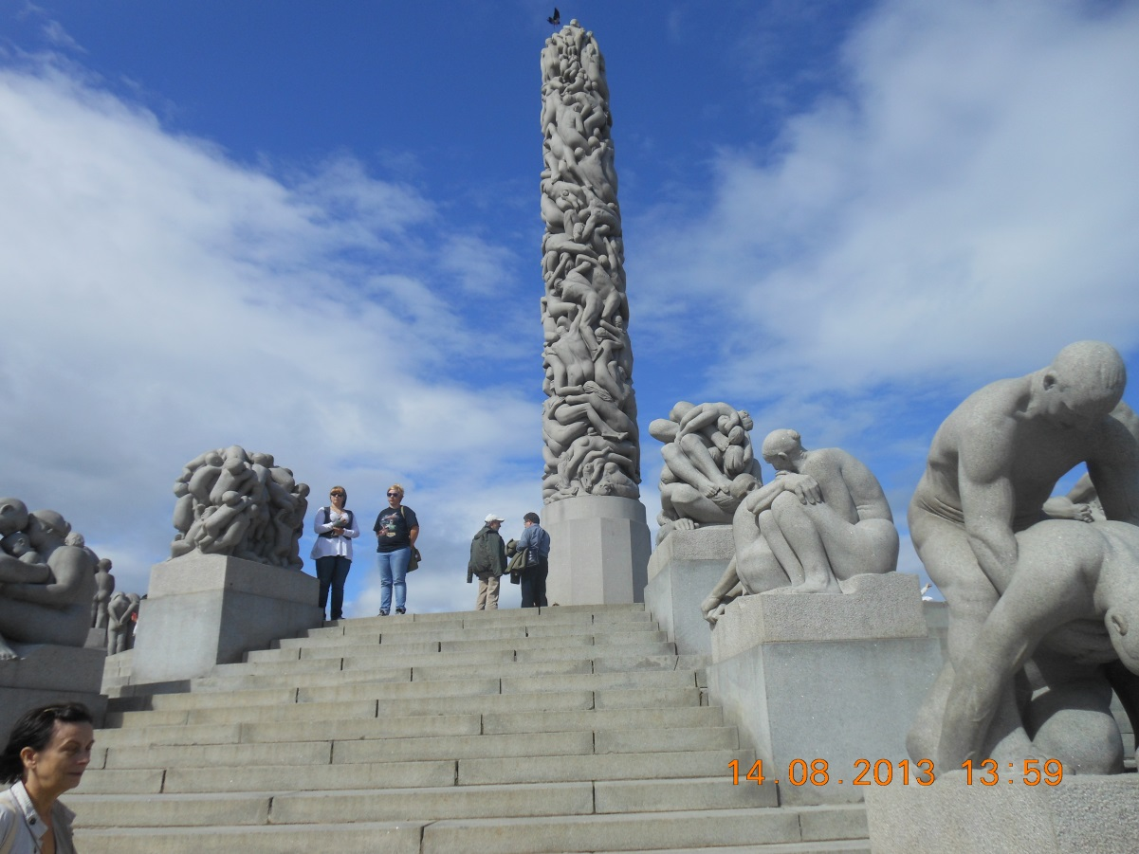
Having stopped in Oslo we visited one of the most noticeable sights Frogner-park, the part Vigelan-park - grandiose creation of the sculptor self-educated person Gustav Wigelan is more exact than it.

Slide 6
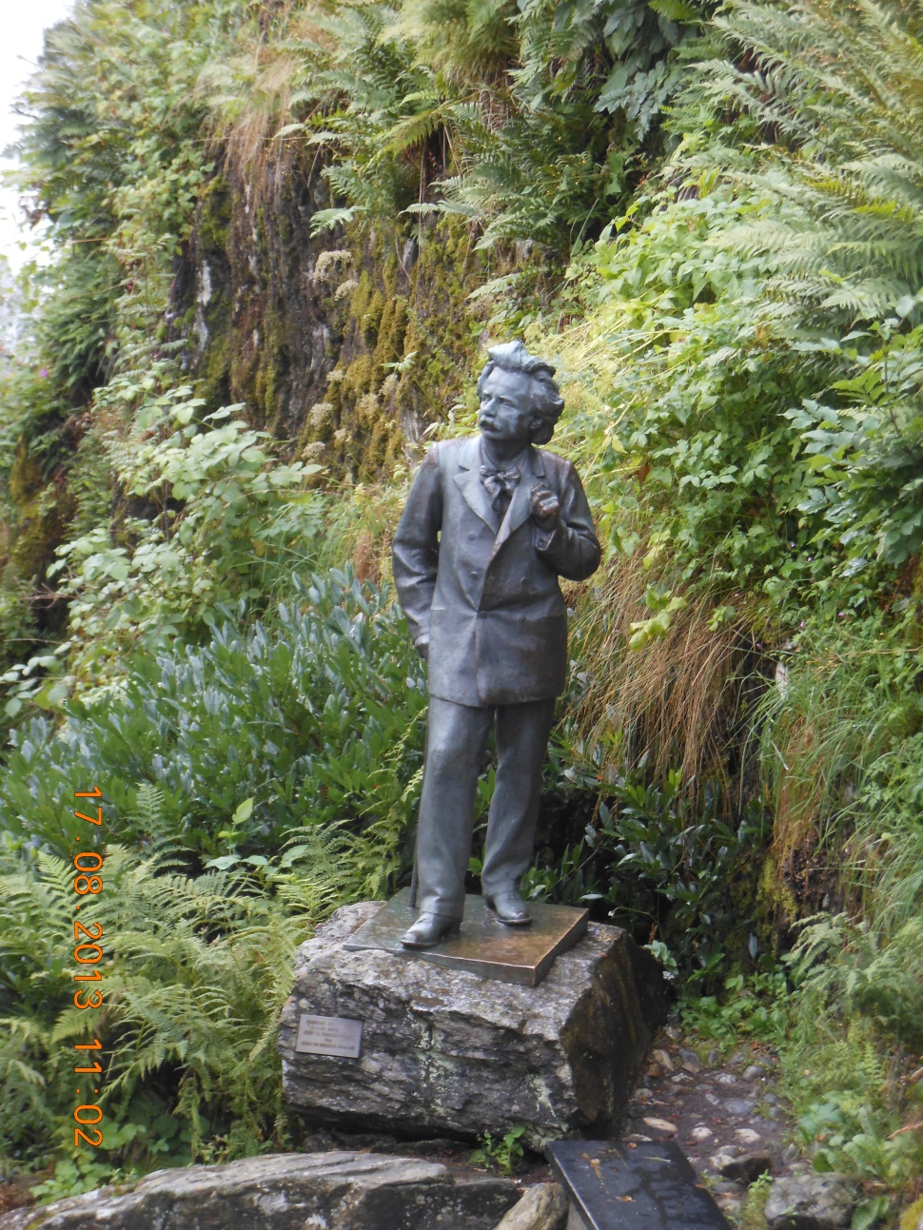
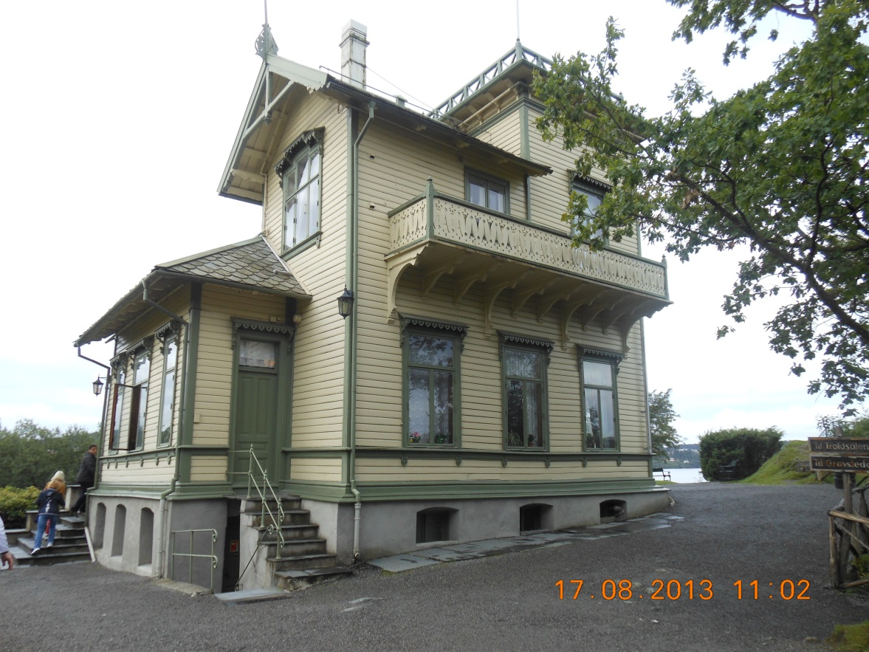
After, we appeared in the city of Bergen where visited a lodge museum of the outstanding composer Edward Grieg. His house is located in the beautiful wood, on the bank of the lake.

Slide 7
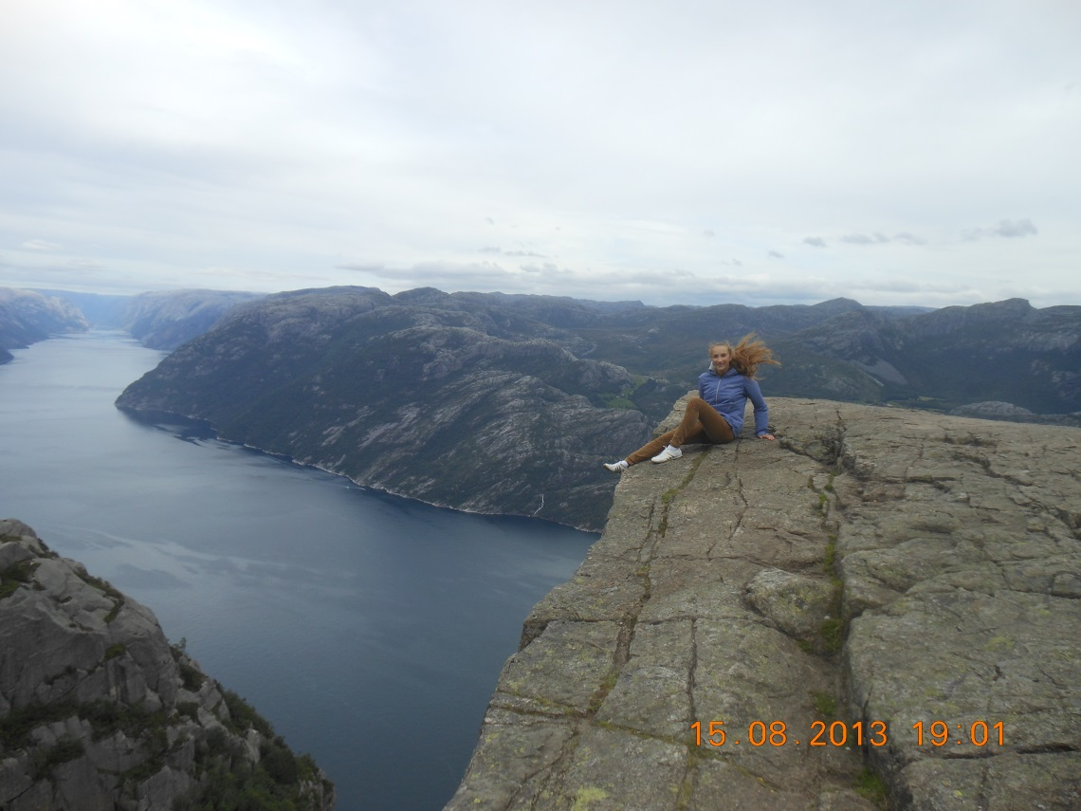
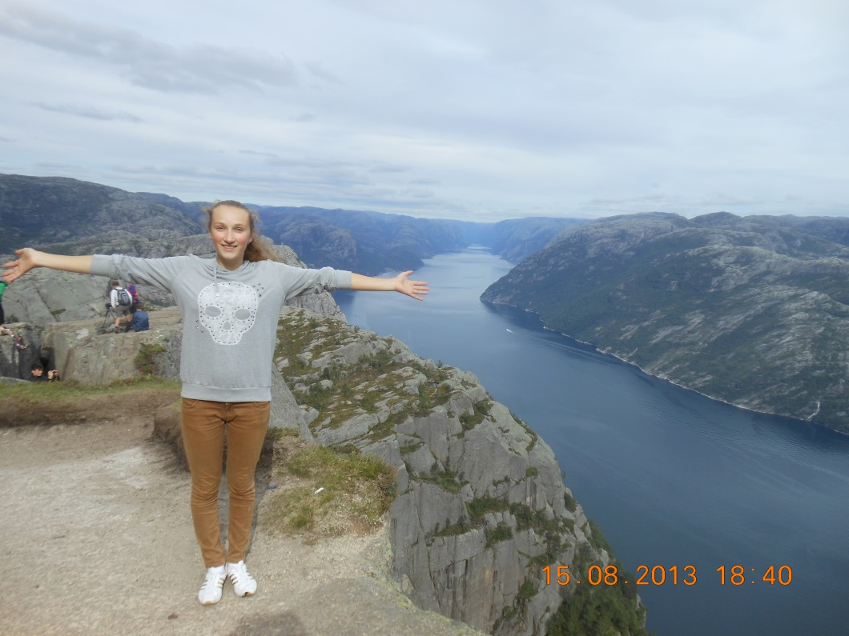
But most of all I was struck by Lyusefyord. Externally the plateau is similar to church chair therefore carries the name "Chair of the Preacher". Its height reaches 604 meters. Not all could master long and heavy rise on the fjord but when you overcome long distance that to your eyes the picture which can't be described words opens.

