Slide 1
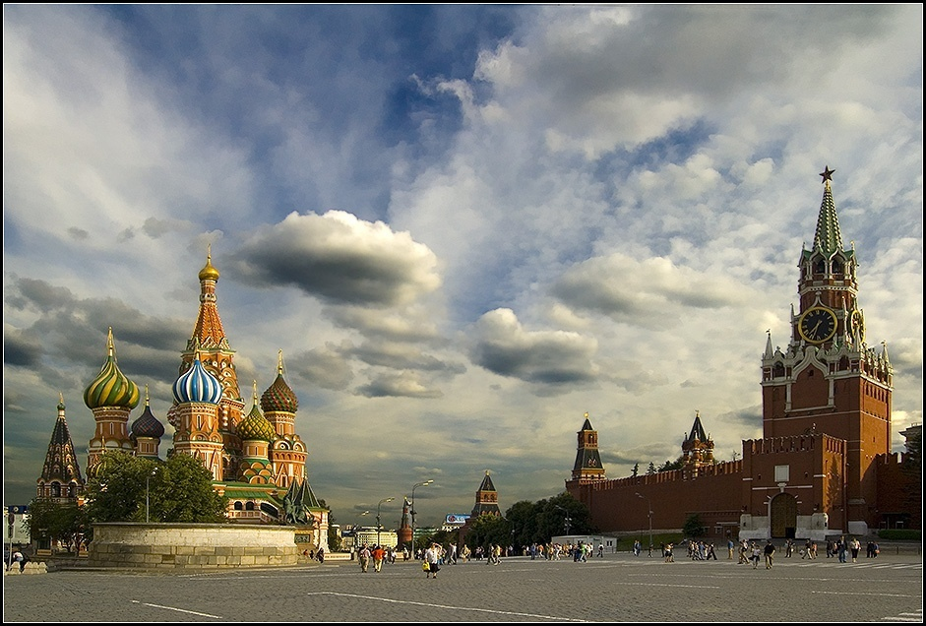
Moscow
Козыренко Ян 5В МБОУ СОШ №18
Moscow

Slide 2
Answer the questions:
What is Moscow famous for?
On what river does Moscow stand on?
Why is Moscow the seat of the Russian government?
What other important institutions are there in Moscow?
What is the central square called?
What can a visitor see there?
What is the most famous theatre called?

Slide 3
Moscow, the capital of Russia, is one of ancient Russian cities.

Slide 4
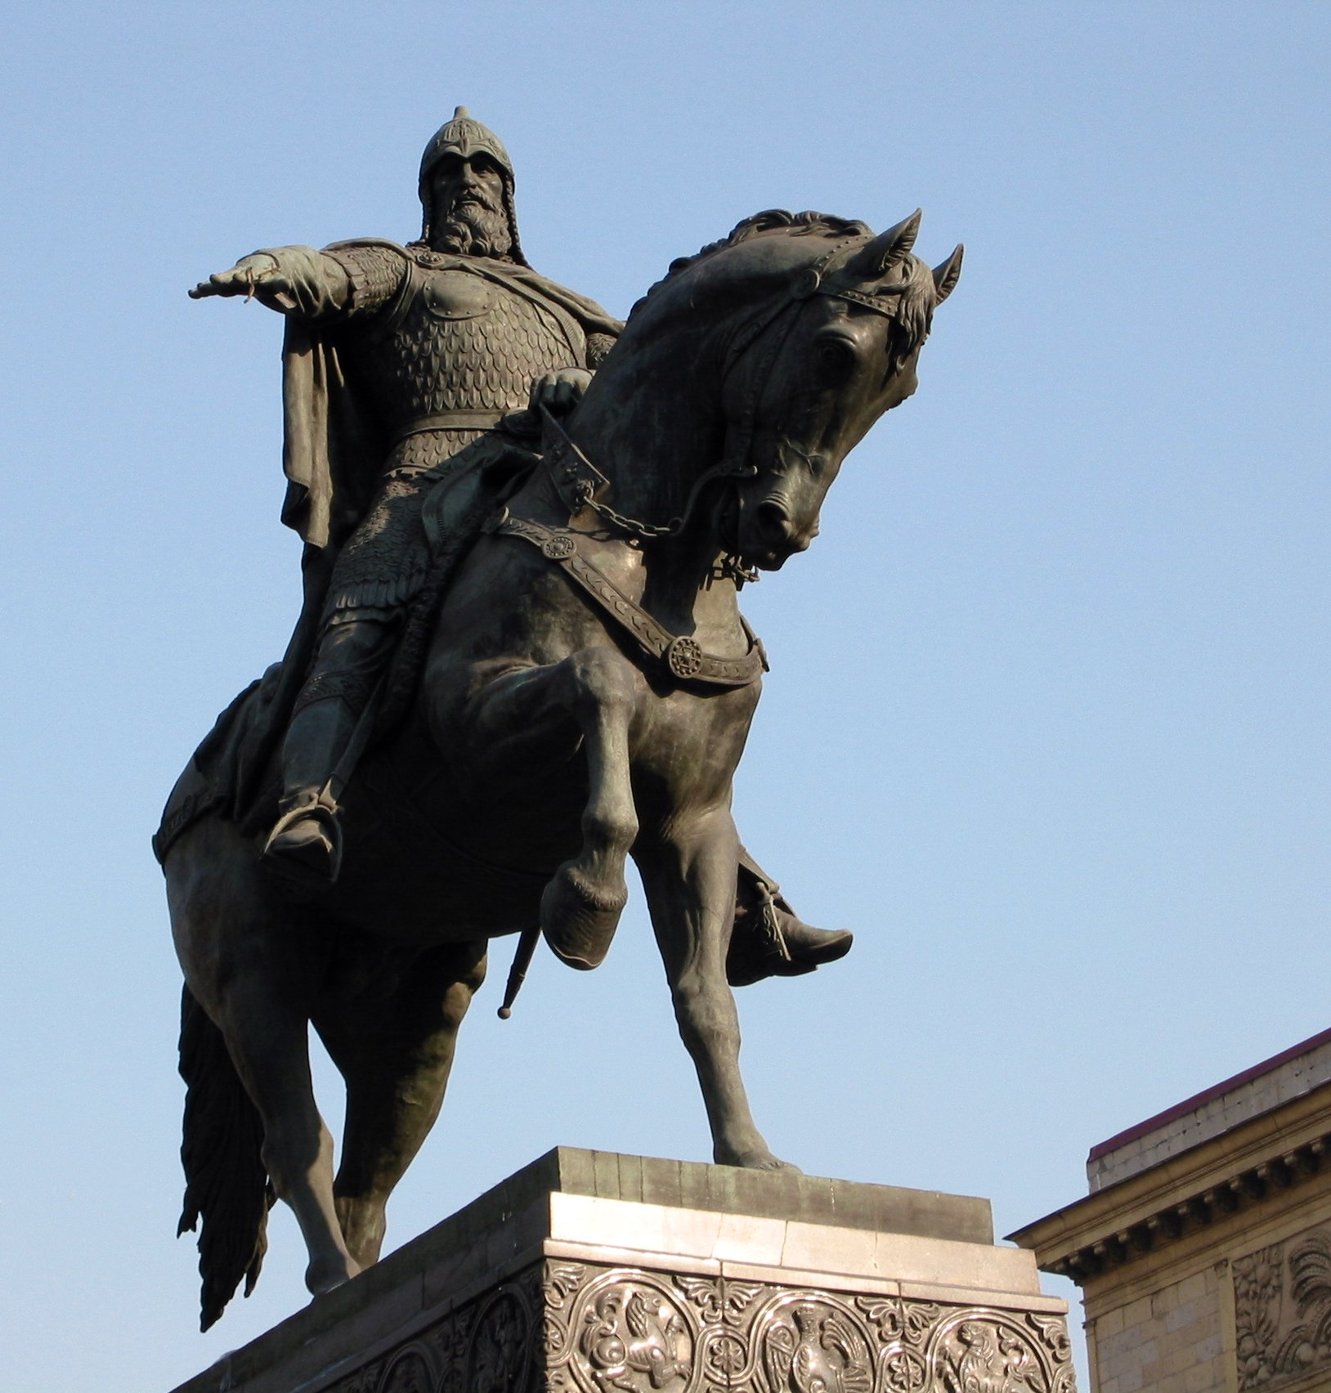
It was founded by Prince Yuri Dolgoruki in 1147.

Slide 5
The city stands on the Moskva River.

Slide 6
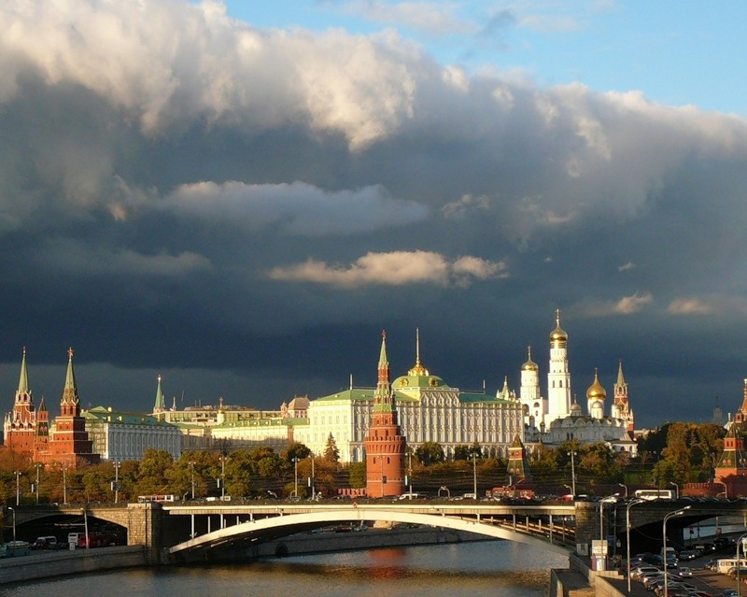
Moscow is the country's political, economic, religious, financial, educational and transportation centre.

Slide 7
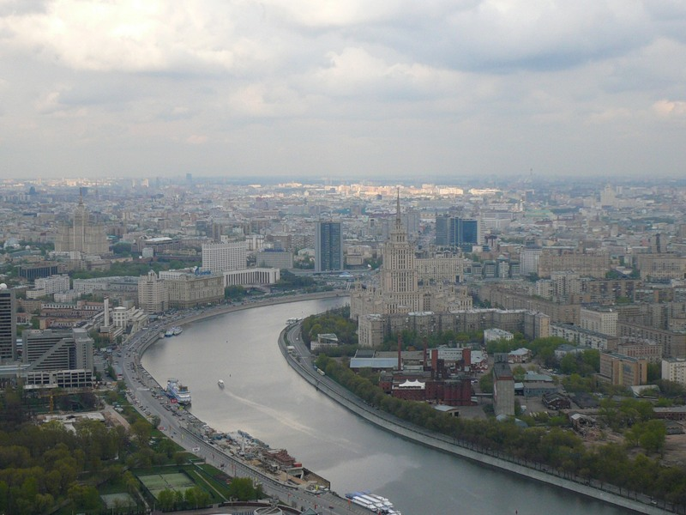
Its total area is about 900 sq. km.

Slide 8
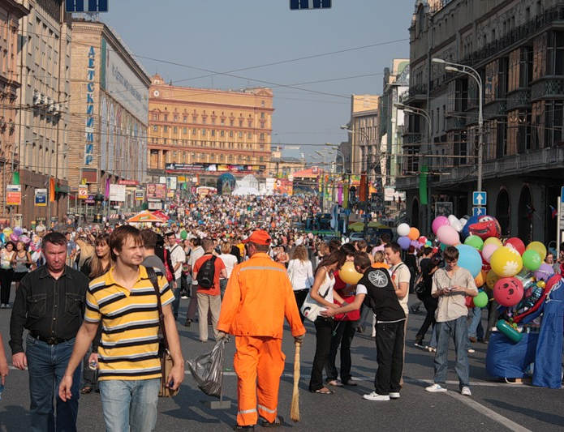
About 11 million people live in Moscow.

Slide 9
Moscow is the seat of the Russian Government.

Slide 10
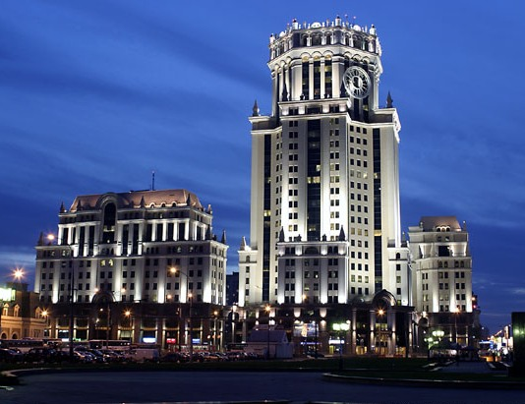
Paveletskaya Tower, a business centre
It is a financial and business centre of
the country.

Slide 11
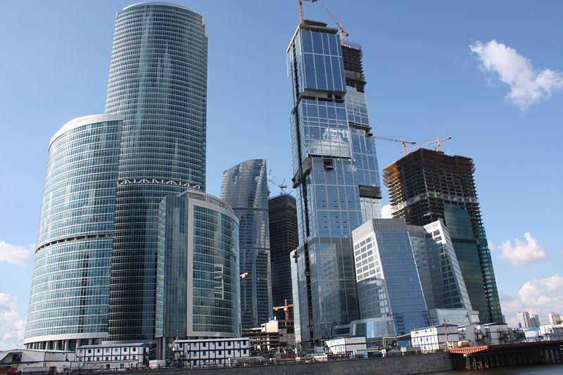
The "Moscow International Business Centre"

Slide 12
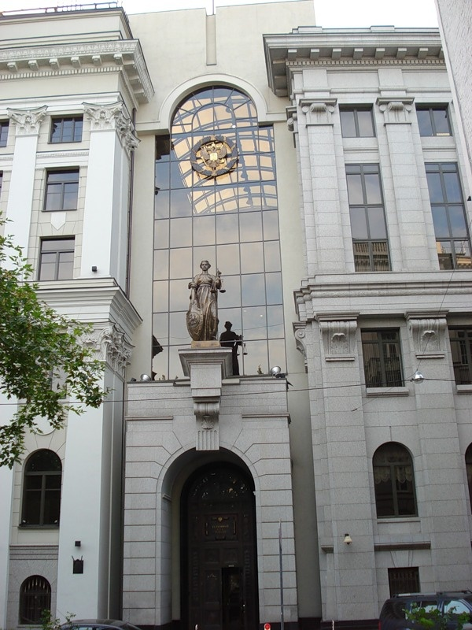
The Supreme Court of Russia is a place where laws are interpreted.

Slide 13
Moscow is one of the most popular tourist destinations.

Slide 14
The heart of Moscow is the Kremlin.

Slide 15
Its 20 towers attract tourists from all over the world.

Slide 16
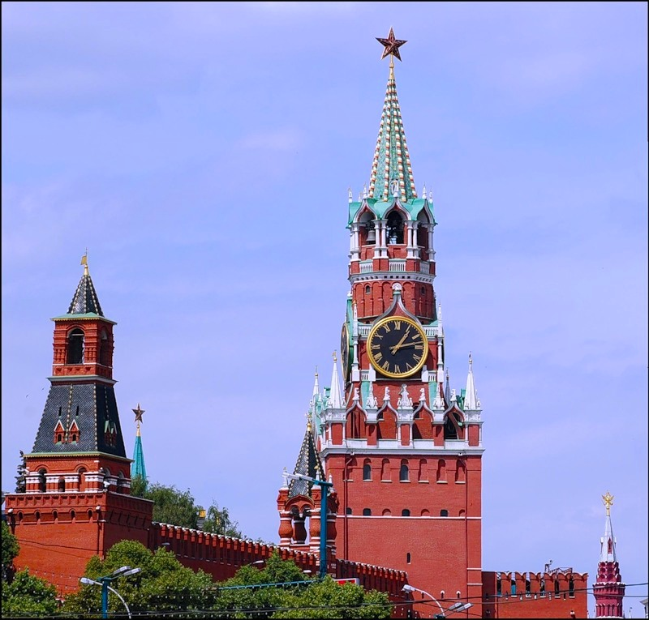
The main tower is the Spasskaya Tower. The famous clock called Kuranty strikes on it.

Slide 17
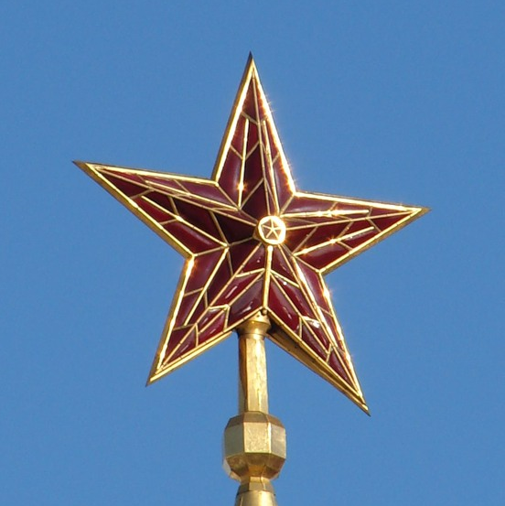
On top you can see a ruby star. Its diameter is 1.5 metre.

Slide 18
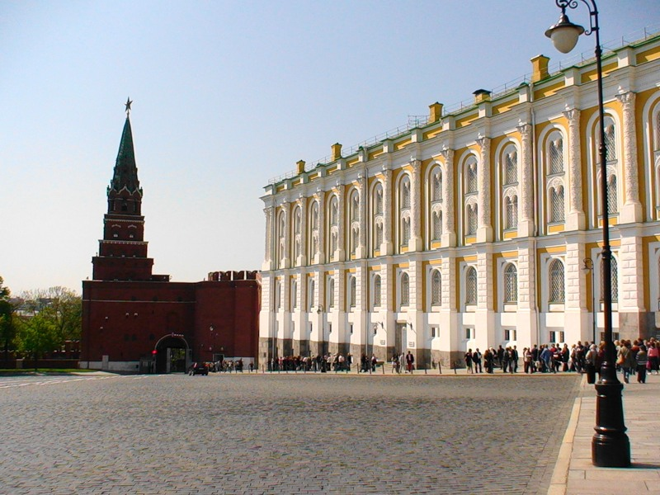
The Kremlin Armoury is one of the oldest museums of Moscow, established in 1808 and located in the Moscow Kremlin. It contains collections of weapons, jewelry and various household articles of the tsars.

Slide 19
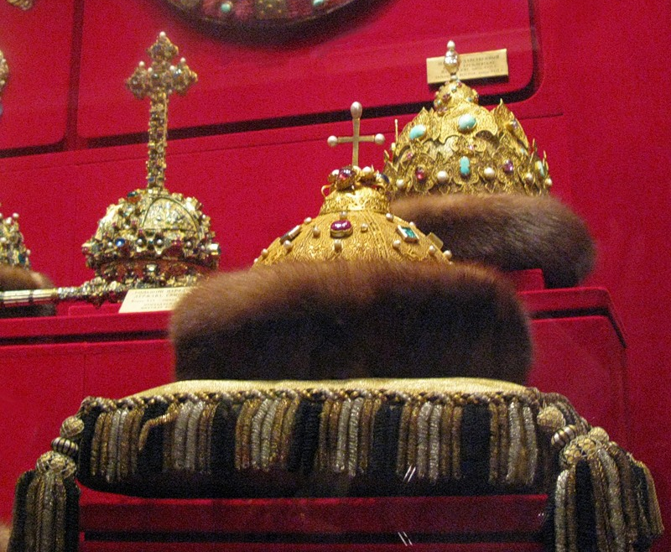
Monomakh's Cap was the crown of all Muscovite Grand Princes and Tsars from Dmitri Donskoi to Peter the Great.

Slide 20
The Tsar Cannon on the territory of the Kremlin is 5.34 m long and weighs about 40 tons. It was made by A. Chokhov in 1594.

Slide 21
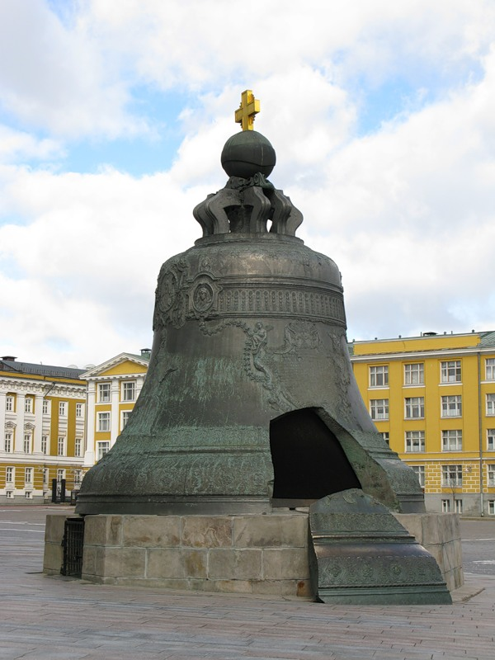
The Tsar Bell is 6.24 m high and weighs about 200 tons. Its diameter is 6.6m. It was made by I.F. Matorin and M.I. Matorin in 1733-1735.

Slide 22
Near the Kremlin Wall there is the Unknown Soldier’s Grave. People come here to honour the unknown soldiers killed during the Second World War.

Slide 23
One of the most famous sights is Red Square.

Slide 24
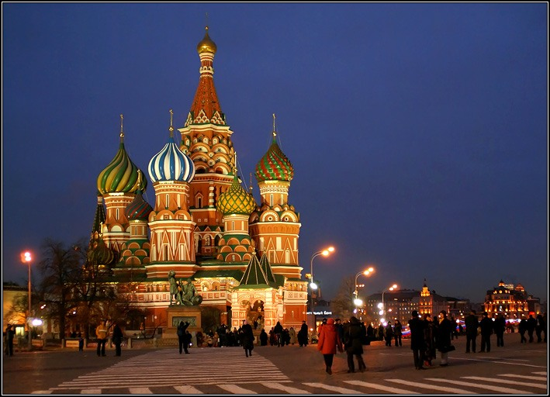
St. Basil’s Cathedral was erected in 1555- 60 by two architects Postnik and Barma.

Slide 25
The monument to Minin and Pozharski was designed by Ivan Martos in 1818.
Its height is 8.8 m.

Slide 26
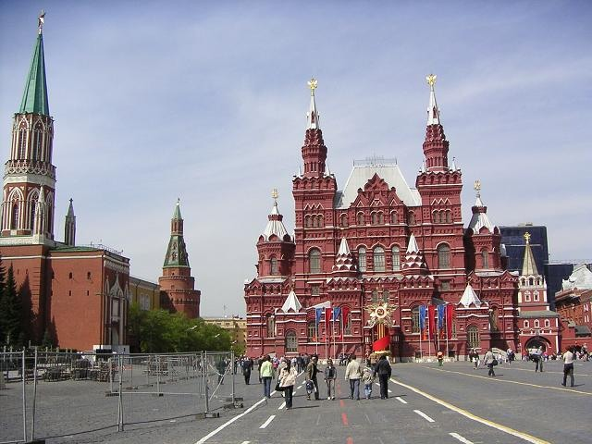
The Moscow State Historical museum of Russia was founded in 1872.

Slide 27
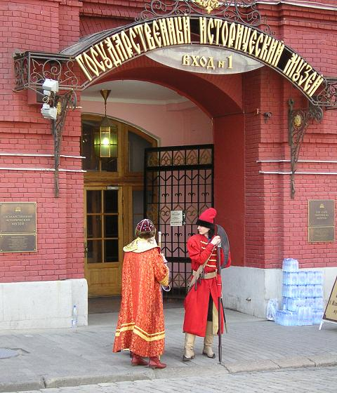
The total number of objects in the museum's collection numbers in the millions.

Slide 28
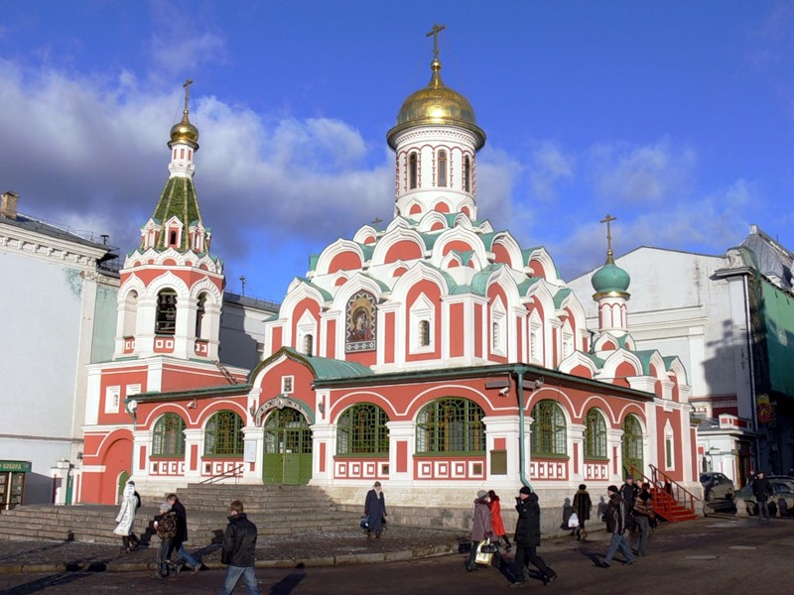
Kazan Cathedral is also located in Red Square. It commemorates the liberation from the Polish aggressors in 1612.

Slide 29
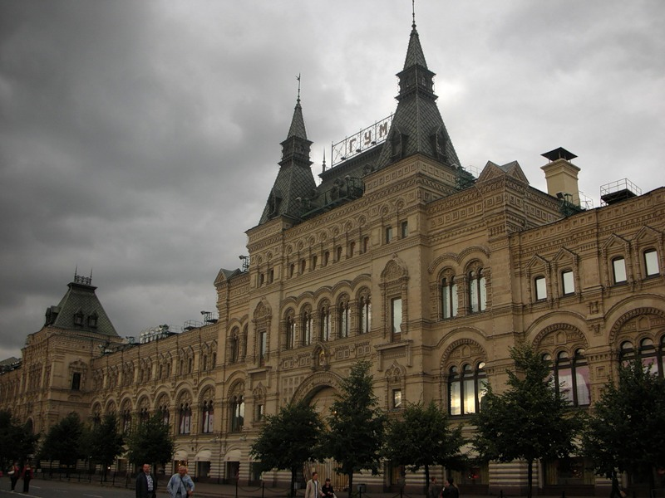
You can buy presents for your friends and relatives in GUM right here in Red Square.

