Slide 1
life in the rear
Презентация ученицы 10 «Б»
МБОУ СОШ №18.
Магомедова Регина
(TYL)
As we lived in the rear during the great Patriotic War

Slide 2
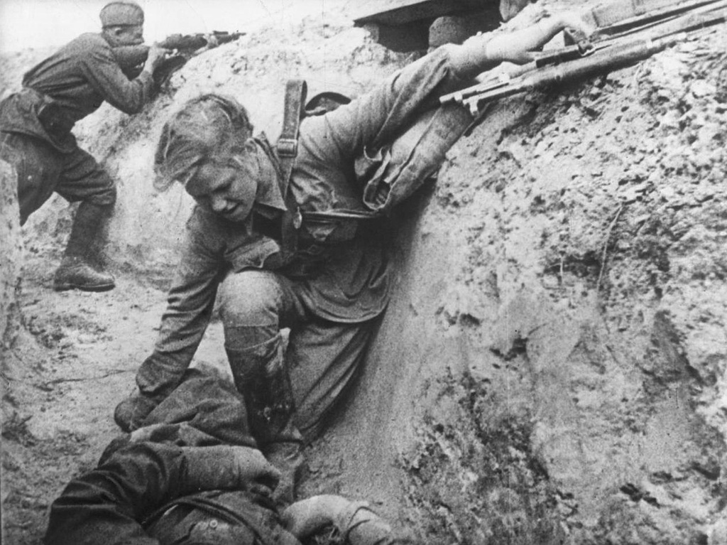
Soviet nurse is assisting a wounded soldier under enemy’s fire.

Slide 3
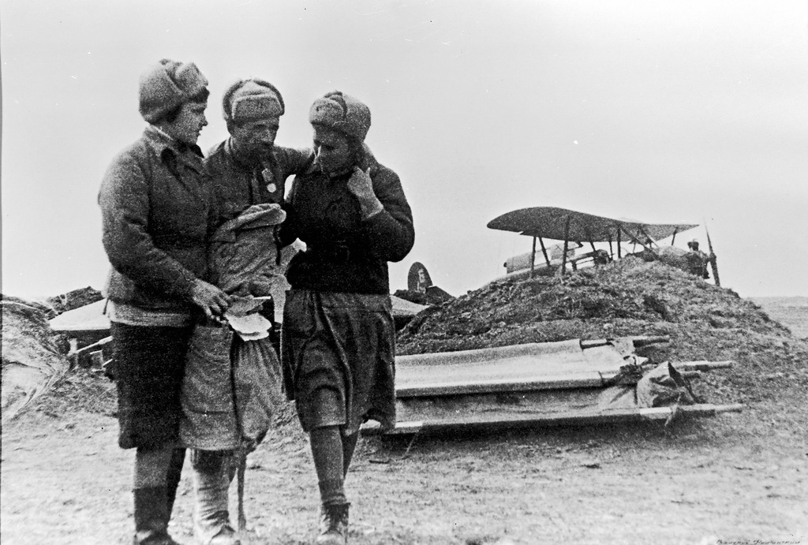
Soviet nurses are delivered wounded soldier to the rear of the plane C-3.

Slide 4
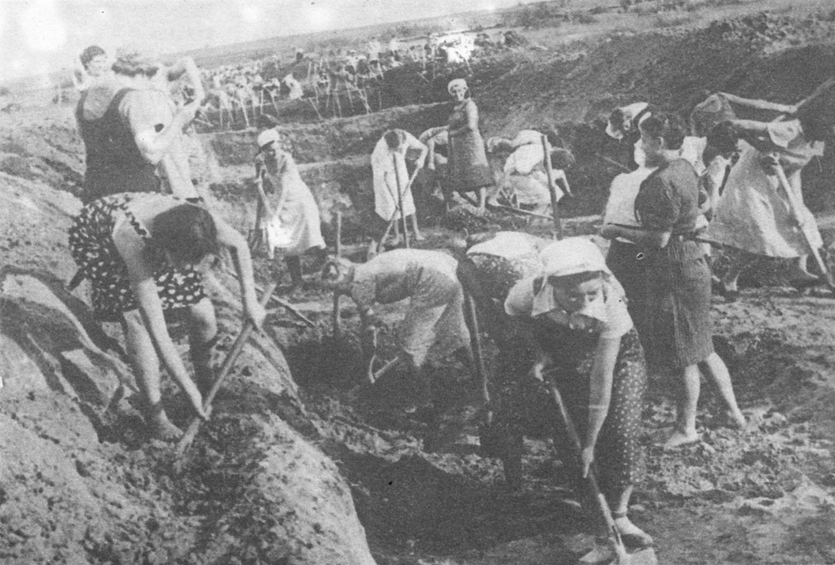
July 1941 women of Leningrad dig anti-
tank trenches.

Slide 5
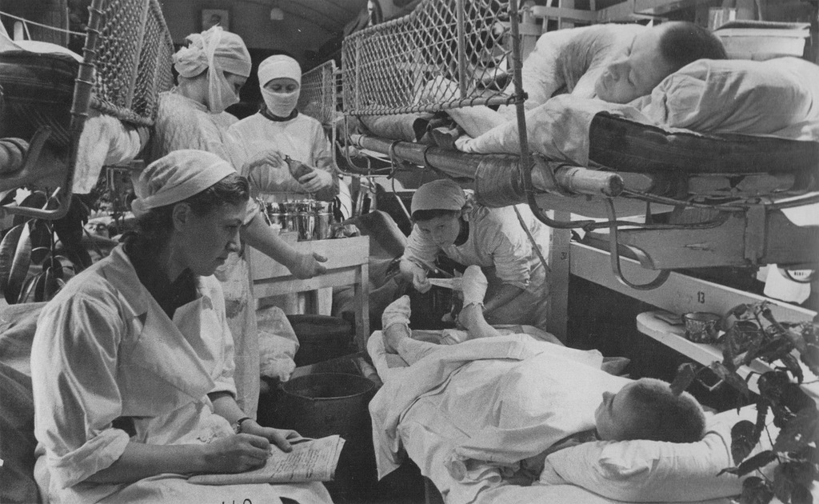
Hospital train.
Women doctors rebandage the wounded in the wagons of the Soviet military.

Slide 6
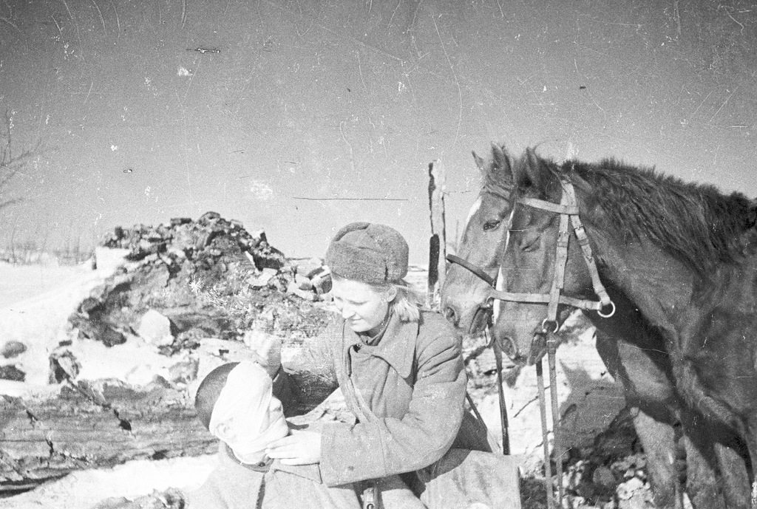
A medical bandaging the head of a wounded soldier in the streets of the village.

Slide 7
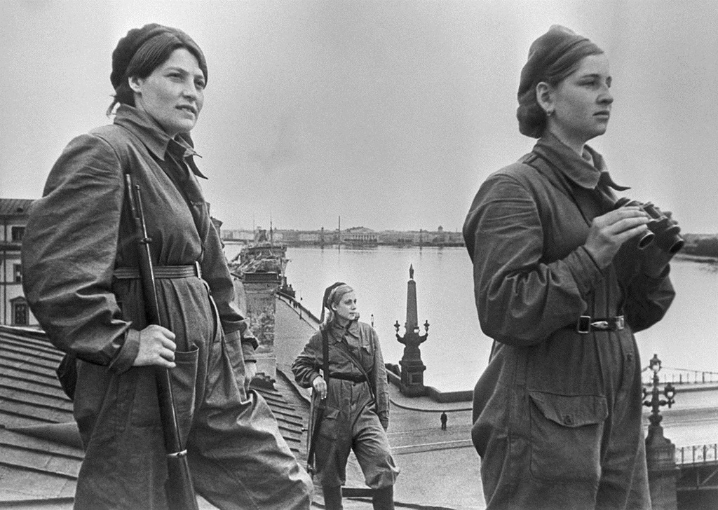
Women fighters. Air defenders are on combat duty on the roof of the house

Slide 8
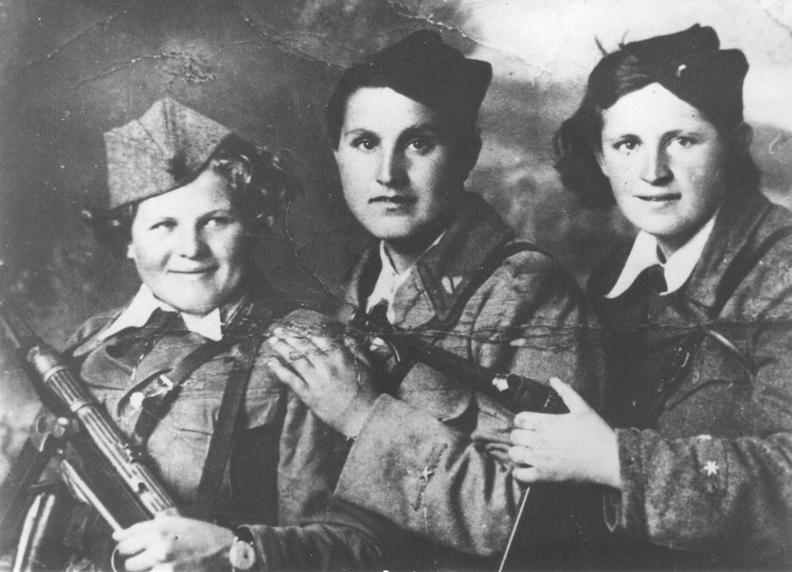
Women were brave and responsible.

Slide 9
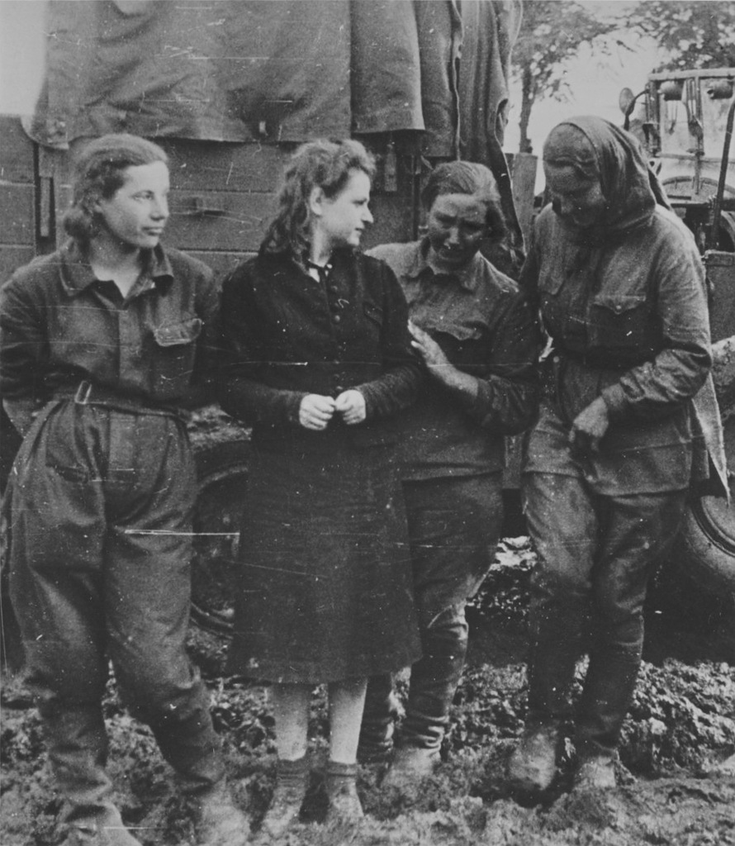
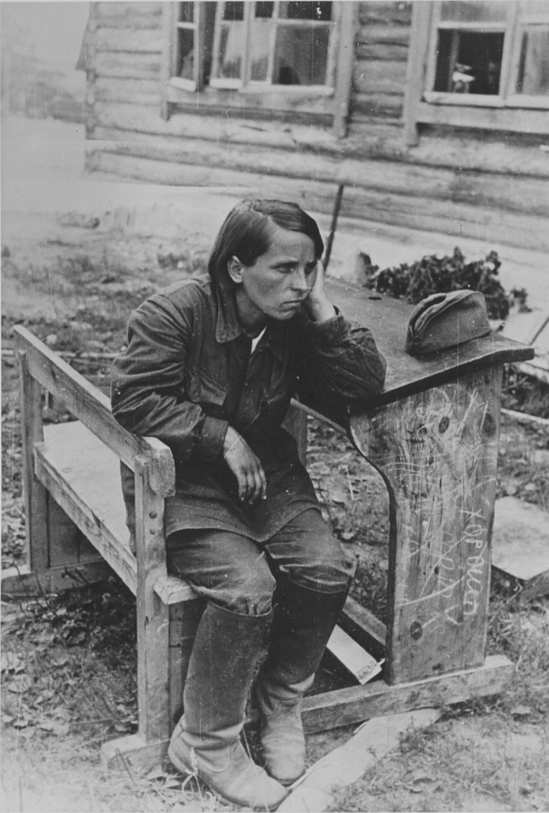

Slide 10
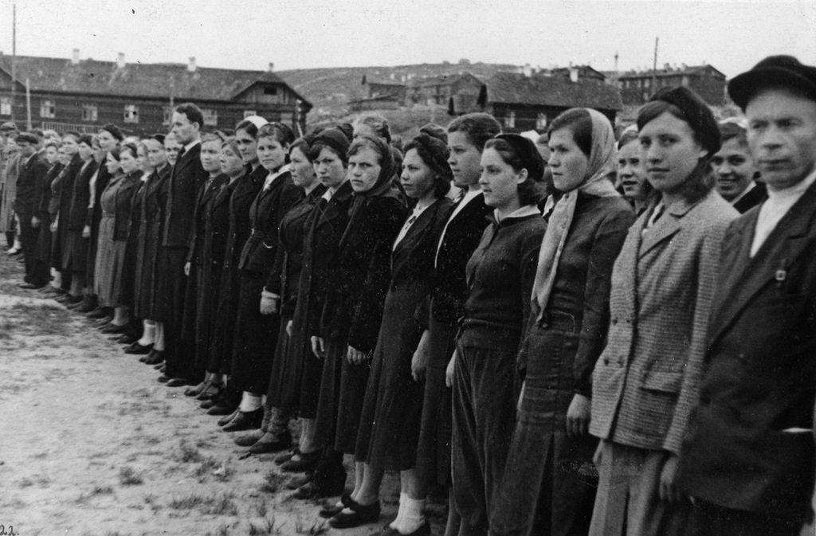

Slide 11
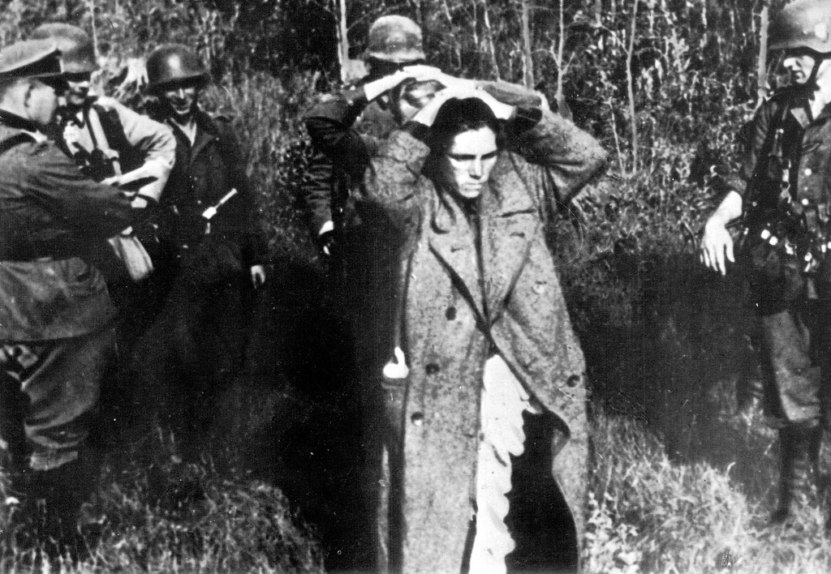
German soldiers take out arrested Soviet women-partisan from the forest .

Slide 12
The country has not forgotten deeds of labor people. In 1946 and 1947 4929 people from Nazarovo were awarded the medal "For valiant labor in the great Patriotic war 1941-1945". Between them 4333 - agricultural workers. Among the recipients were not only adults but also children.

Slide 13
Thank you for your attention

