Slide 1
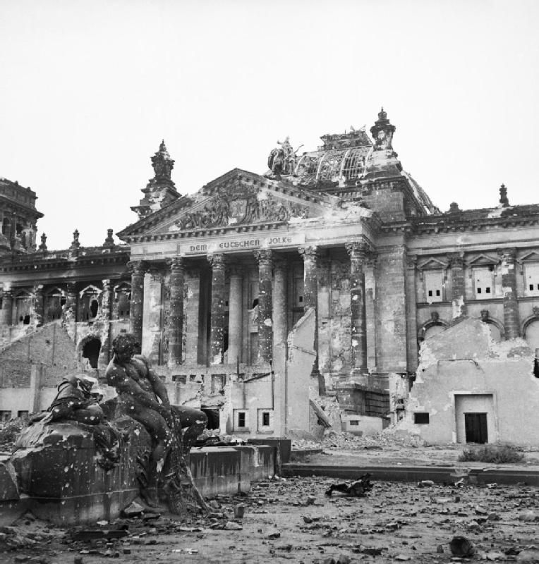
Battle for the Reichstag
Презентация ученицы 10 «Б»
МБОУ СОШ №18.
Чехонацкая Кристина

Slide 2
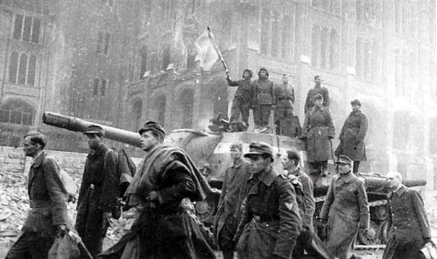
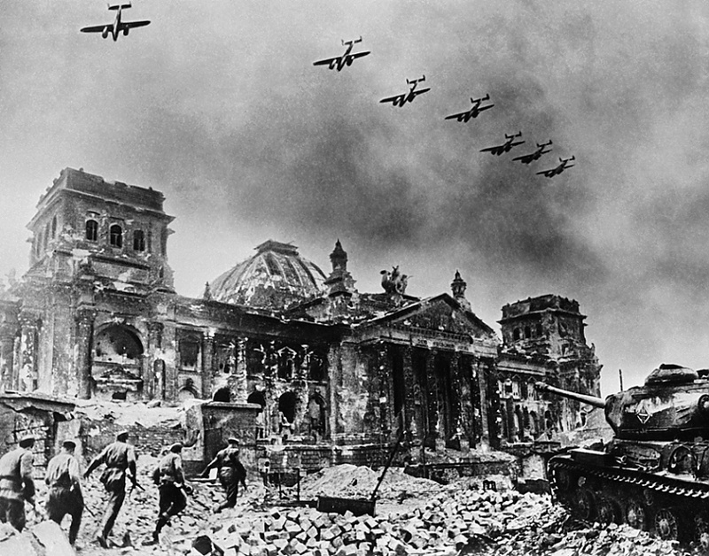
The storming of Berlin - the final part of the Berlin offensive of 1945, during which the Red Army captured the capital of Nazi Germany victoriously completed the Great Patriotic War and the Second World War in Europe. The operation lasted from April 25 to May 2.
Battle for the Reichstag was the key moment of the capture Berlin.

Slide 3
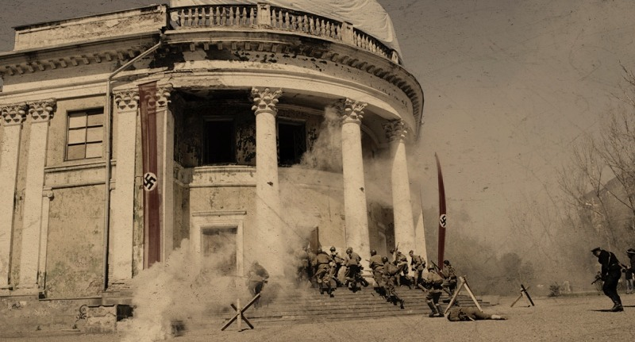
Battle for the Reichstag
Military operation of the Red Army against the German troops on the mastery of the German parliament building. Carried out at the final stage of the Berlin offensive from April 28 to May 2, 1945 by the 150 th and 171 th Rifle Division 79th Rifle Corps 3rd Shock Army of the 1st Belorussian Front.

Slide 4
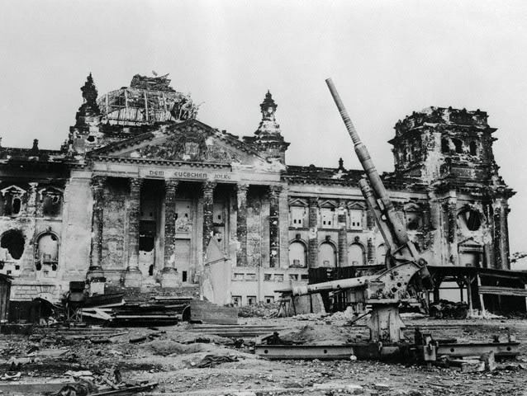
The task of mastering the Reichstag was set on April 28 in combat disposal commander of the 79th Rifle Corps Major General S.N. Perevertkina:
... 3. The 150th Rifle Division - one rifle regiment - the defense on the river. Spree. Two infantry regiments go on the offensive with the task to master the western part of the Reichstag ...
4. The 171 th Rifles Division to continue the offensive in its borders with the task to master the eastern part of the Reichstag ...

Slide 5
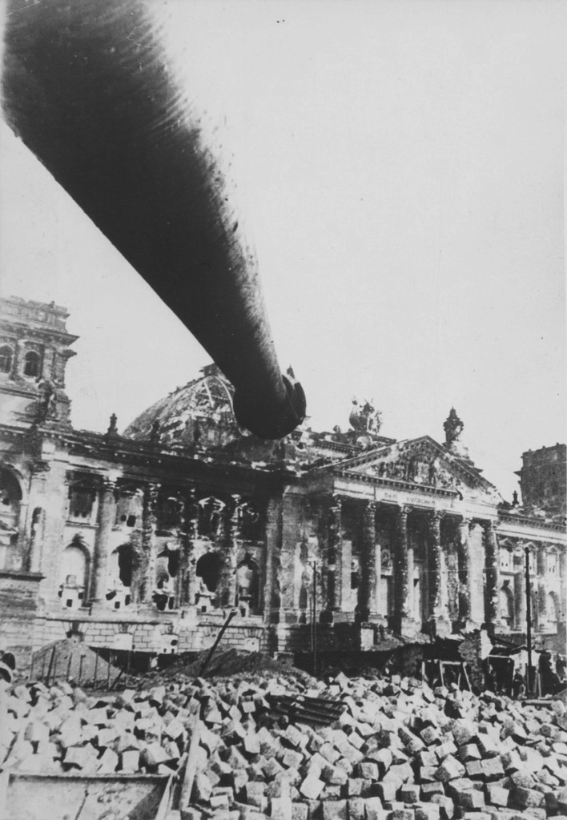
April 29
The next target on the way to the Reichstag building was the Ministry of Internal Affairs, nicknamed the Soviet soldiers' House Himmler. Subsequent day part of the 150th Rifle Division fought for the building and to the dawn of April 30 captured it. Way to the Reichstag was opened.

Slide 6
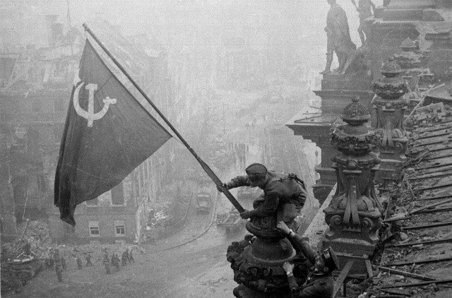
May 1
Early in the morning on May 1 A.P. Berest, M.A. Yegorov and M.V. Kantariya hoisted the flag of the 150th Infantry Division over the Reichstag, which later became the Banner of Victory.

Slide 7
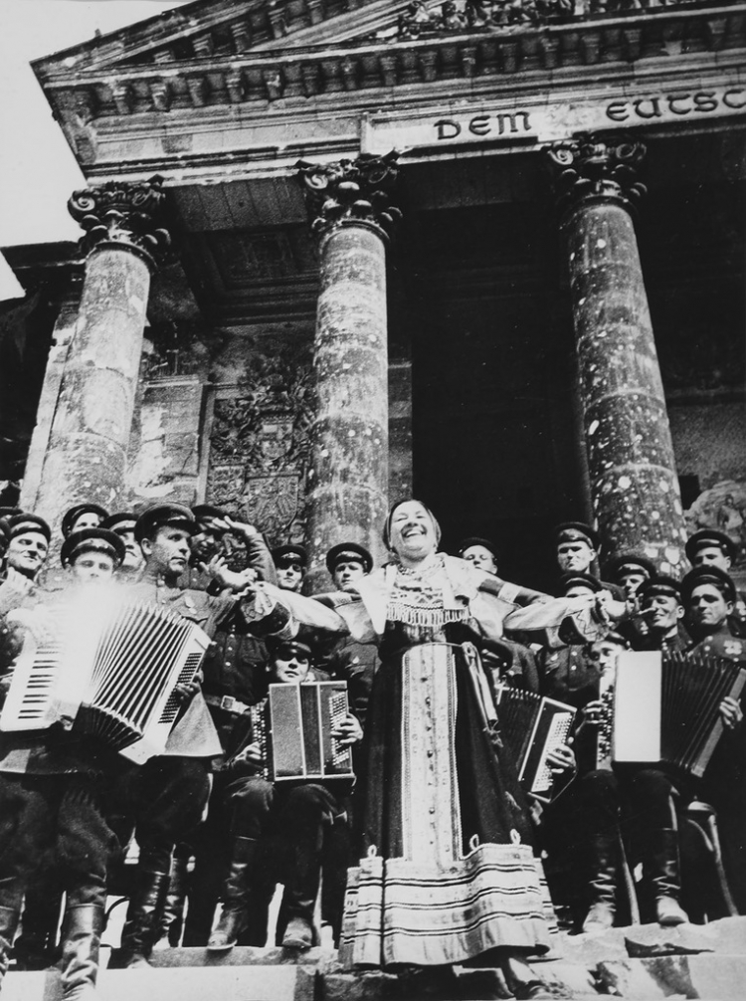
However, the battle for the Reichstag lasted all day. Soviet soldiers had to battle with the enemy and at the same time fight the fire. Fight in a burning building lasted until late in the evening. And only in the early morning of May 2 German garrison surrendered.

Slide 8
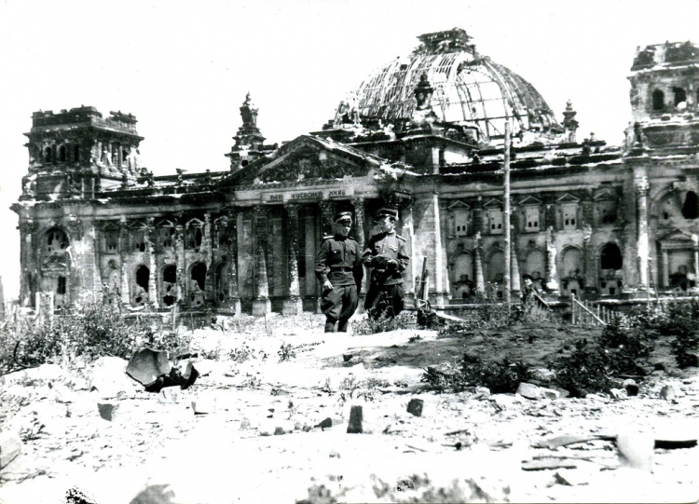
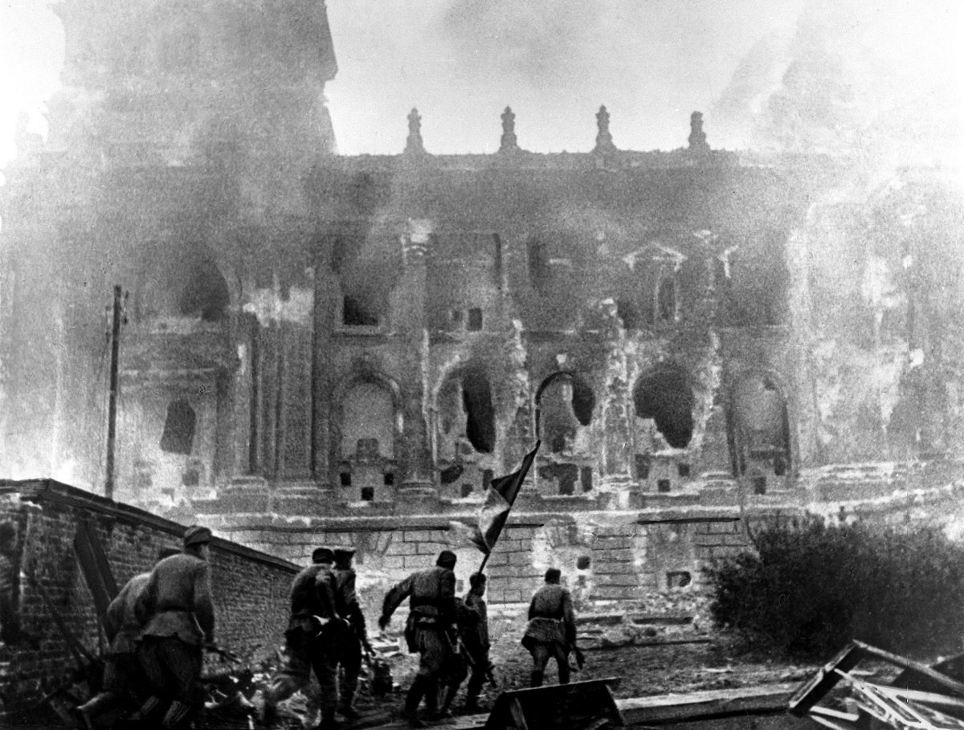
April 30
April 30, 1945 in 21 hours and 45 minutes part of the 150th Infantry Division under the command of Major-General V.M. Schatiloff and 171st Infantry Division under the command of Colonel A.I .Nehoda captured the first floor of the Reichstag building.

Slide 14
Thank you for your attention!

